Slide 1



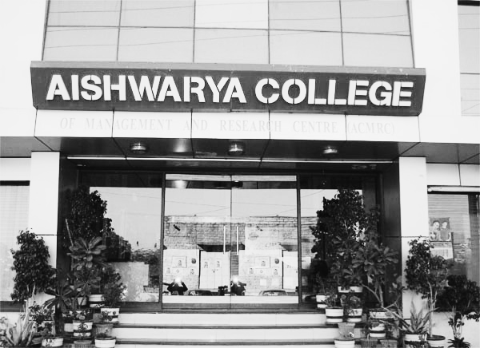
Strategic Analysis and Enhancement of Admission Dynamics at Aishwarya College
A DATA-DRIVEN ANALYSIS AND ACTION PLAN FOR AISHWARYA COLLEGE
BY:
Daiwik Rankawat (22f3000099)

Slide 2





ABOUT AISHWARYA COLLEGE
Overview
Institution Background
Admission Challenges
Project
Objective
Established 2018.
Dedicated undergraduate institution offering BSc, B.Com, BCA, and BA program.
Experiencing year-over-year decline in admission numbers requiring strategic changes
Identify admission problems and optimize strategies through comprehensive data analysis

Slide 3
DATA COLLECTION OVERVIEW
Comprehensive admission data spanning three years (2021-2023) with detailed student information and academic metrics.
Data Field | Description | Data Type
Personal Info | Name, Gender, DOB, Category | Demographic
Academic Details | 10th/12th scores, Pre-qualifying test | Academic
Program Selection | Program, Field of Study, Mode | Academic Choice
Geographic Data | Home Address, Distance from College | Location
Financial Info | Family Income, Fee Structure | Economic
Timeline | Date of Admission, Year-wise trends | Temporal
Data was already cleaned and well structured

Slide 4
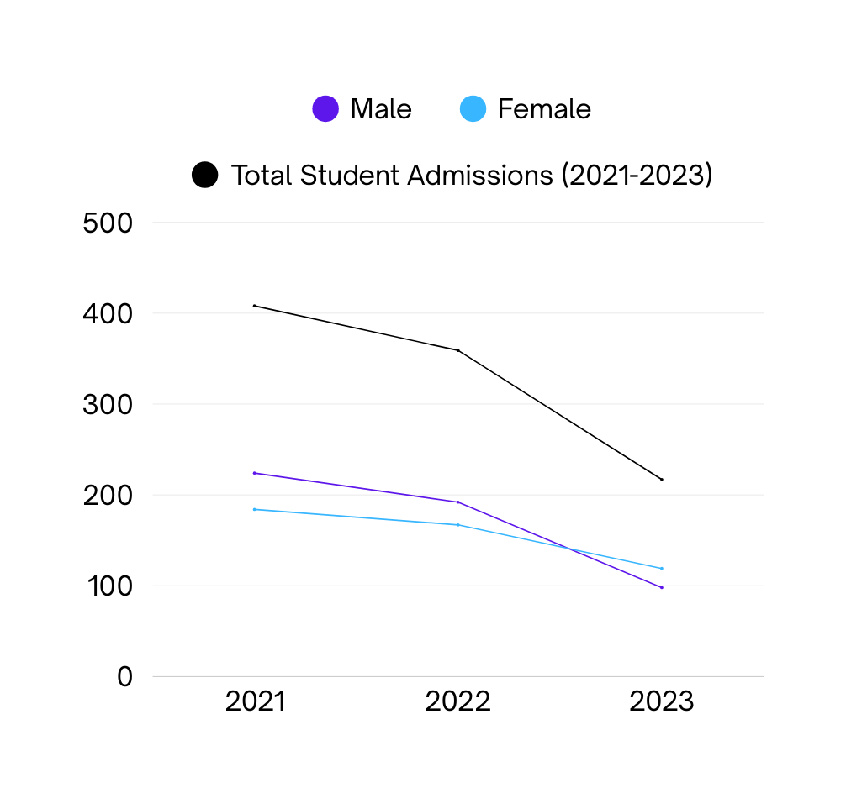
An analysis of three years of admission data reveals a critical revenue leak and a clear path to recovery.
The Situation: Aishwarya College is experiencing a concerning decline in annual admissions, with numbers falling from 408 in 2021 to 217 in 2023.
The Core Problem: A significant number of students are 'switching streams' after admission-primarily from higher-fee Science programs to Arts and Commerce.
The Financial Impact: This academic mismatch has led to a direct and quantifiable revenue leakage of approximately 1 crore over the last three years.
The Path Forward: This presentation outlines a targeted, three-part strategy to address the root causes, reverse the trend, and secure the college's financial future.
The 47% drop in admissions from 2021 to 2023 represents not only a loss of students but aut also a significant erosion of our market position and revenue base.

Slide 5
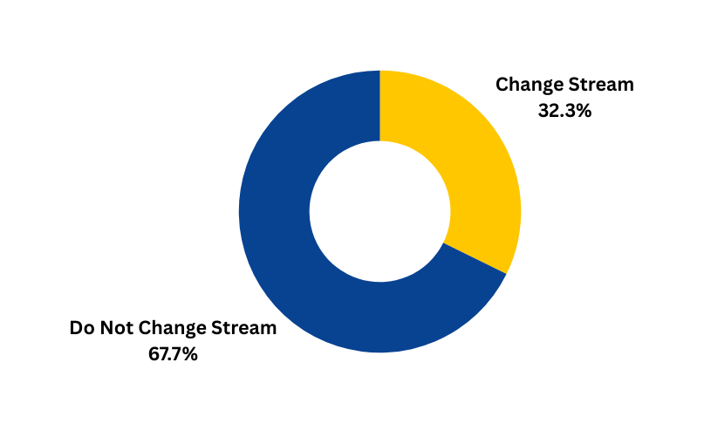
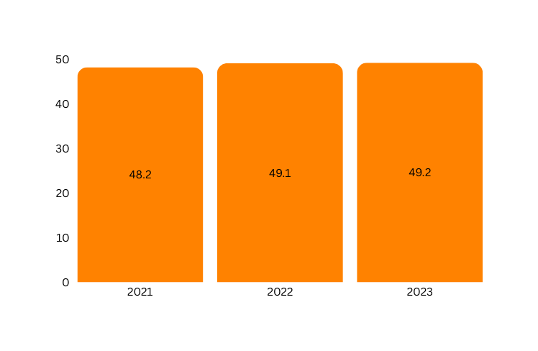
Problem: The big failure: One-third of students abandon their original academic stream, driving revenue loss.
Student Stream Continuity (3-Year Average)
While two-thirds of students continue in their chosen field, the 32% who switch represent a critical misalignment between student expectations and our program offerings. This is where the revenue leakage originates.
Result: The highest volume of transitions occurs from high-fee Science programs to Arts and Commerce.
Avg percentage of student those give Pre Qualifying Test
Pre-qualifying Test
48.8% Avg of students take the test with higher acceptance rates, indicating quality filtering effectiveness
with growth rate of 2.07% from 2021 to 2022 it shows students participation in qualifying test has been increased.

Slide 6
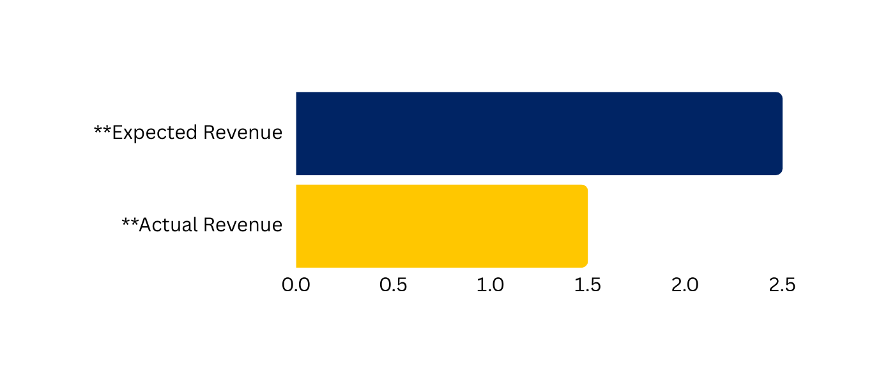

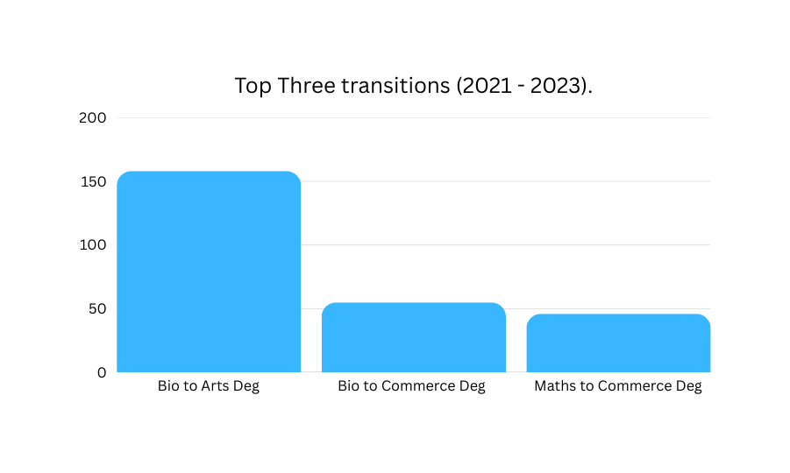
Problem: The Revenue Loss: Stream switching from Science to Arts directly translates to a lower revenue per student, accumulating to a significant loss.
Actual vs. Expected First-Year Revenue from Switching Students (3-Year Total)
Each Science-to-Arts switch results in a per-student revenue drop of ~₹20,000. With 40-50 such switches annually, the losses are substantial. Our most valuable programs, by fee structure, are being systematically underutilized.
₹ 2.5 Crores
₹ 1.5 Crores
Science students are not seeing value in continuing their domain at Aishwarya. This suggests our Science and Tech offerings are perceived as outdated, lack facilities, or are poorly marketed compared to Arts and Commerce.
This creates transition of students from their own stream to different stream, which leads to revenue loss.

Slide 7
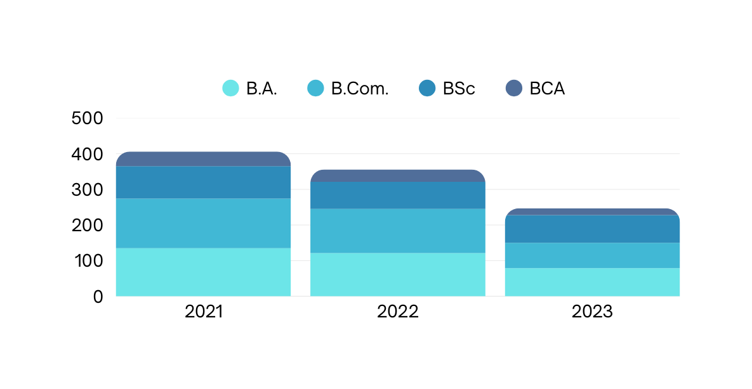
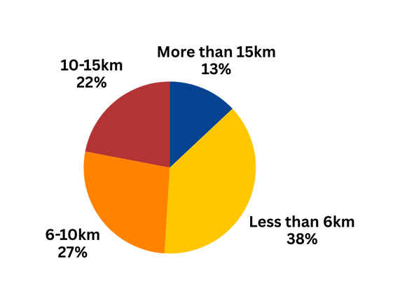
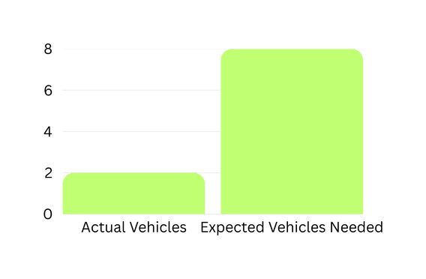
Problem: Structural Growth Bottleneck — Transport and program misalignment limit enrolment growth and competitiveness
UG Program Enrollment Trends (2021-2023)
Program enrollment is misaligned with market demand, with an over-reliance on traditional Arts and Commerce streams.
Despite national trends favoring technical degrees, our admssions are dominated by Arts and Commerce. This signals a critical gap in how our Science and Computer Application programs are perceived, promoted, and structured, leading to under-enrollment in high-potential fields.
Student Proximity to Campus (3-Year Average)
A heavy reliance on students from outside the immediate area is strained by inadequate transportation infrastructure.
The majority of our students commute over significant distances, yet our transport capacity is severely lacking. This creates a daily obstacle and a major safety concern for parents, likely deterring many potential applicants.
Ex: Transport Capacity Gap (>15km)

Slide 8
Solution 1: Realign Academic Offerings to Prevent Stream Switching and Meet Market Needs
Academic Realignment & Program Innovation
Stop the leak by making our programs, especially in Science, more attractive and career-aligned.
Step : 1
Step : 2
Step : 3
Introduce Career-Oriented Programs
Implement Mandatory Career Counseling
Offer Bridge Courses
Create short orientation courses to help students from diverse backgrounds adapt to the rigors of Science or Tech programs, reducing academic anxiety.
Launch modern UG degrees aligned with job markets (e.g., Data Biotechnology, Al & Ethics).
Conduct program-specific counseling during the admission window to affirm students' choices and showcase the value of our Science/Tech tracks.

Slide 9
Solution 2: Enhance the Admission Process to Attract and Convert High-Potential Students.
Admission Process Enhancement
Attract higher-quality, better-fit applicants using a merit-based, data-driven approach.
Launch a Pre-Admission Scholarship Test: Model a test after NEET/JEE to identify and attract top talent early in the admission cycle.
Incentivize Participation: Offer tangible benefits like application fee waivers, priority counseling slots, or merit-based tuition discounts to test-takers.
Automate Lead Nurturing: Use WhatsApp and email campaigns to engage inquiries with program guides, faculty profiles, and success stories, keeping Aishwarya top-of-mind.
Inquiry
Key Insight
Our data shows that nearly 50% of applicants already participate in pre-qualifying tests. This indicates a strong appetite for a merit-based admission process.
Scholarship Test
Incentives
Conversion

Slide 10
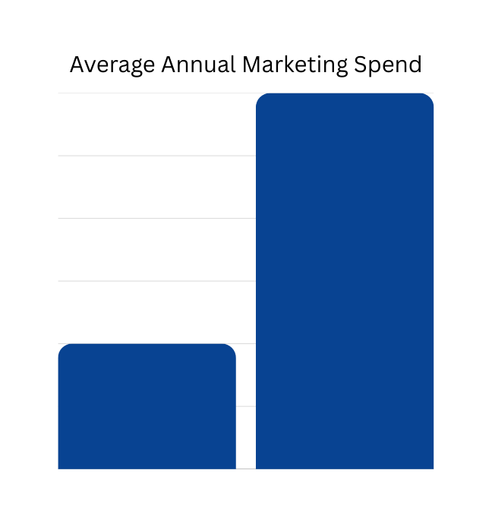
Solution 3: Strengthen Outreach and Remove Barriers to Broaden Our Applicant Pool.
Strategic Outreach & Retention
Remove barriers to entry and actively engage with prospective students, schools, and parents.
Strategically Deploy the Marketing Budget
Utilize the ~14 lakh remaining annual budget (avg.) for targeted digital campaigns, school partnerships, and parent-focused outreach.
Key Insight
Our data shows that nearly 50% of applicants already participate in pre-qualifying tests. This indicates a strong appetite for a merit-based admission process.
Strategically Deploy the Marketing Budget
Utilize the ~14 lakh remaining annual budget (avg.) for targeted digital campaigns, school partnerships, and parent-focused outreach.
Actual Spend
Potential Spend

Slide 11
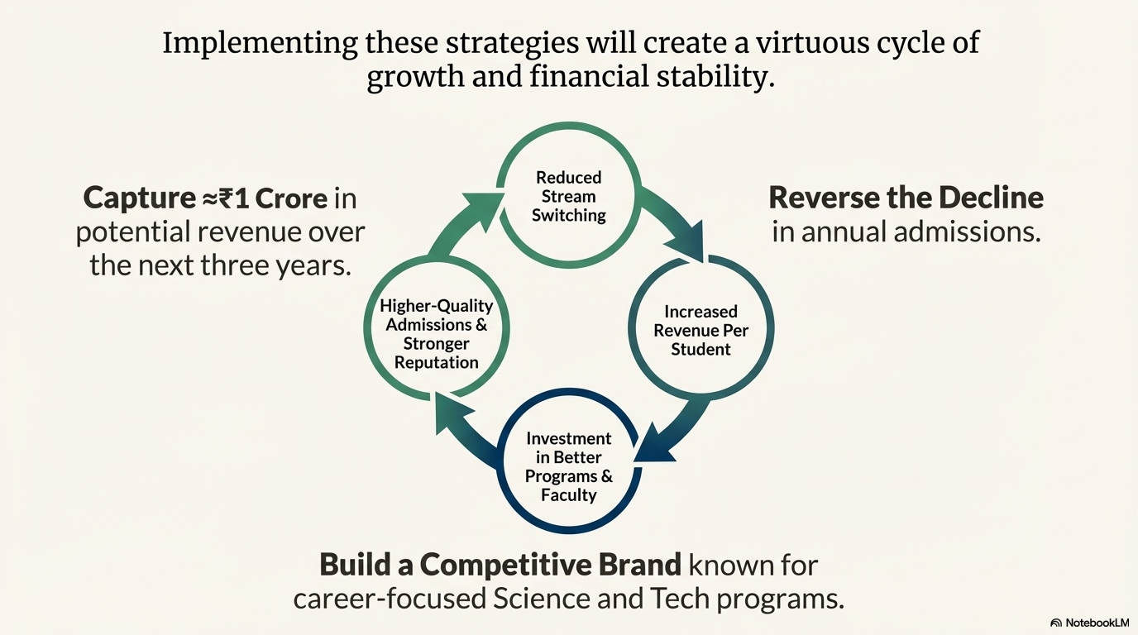

Slide 12

Thank You for Your Attention

